Slide 1
Enabling Computational Journalism: Automated Fact-Checking and Story-Finding
Chengkai Li
Associate Professor, Department of Computer Science and Engineering
Director, Innovative Database and Information Systems Research (IDIR) Laboratory
University of Texas at Arlington
Shandong University, Oct. 9th, 2015
Nanjing University, Oct. 13th, 2015
©2015 The University of Texas at Arlington. All Rights Reserved.

Slide 2
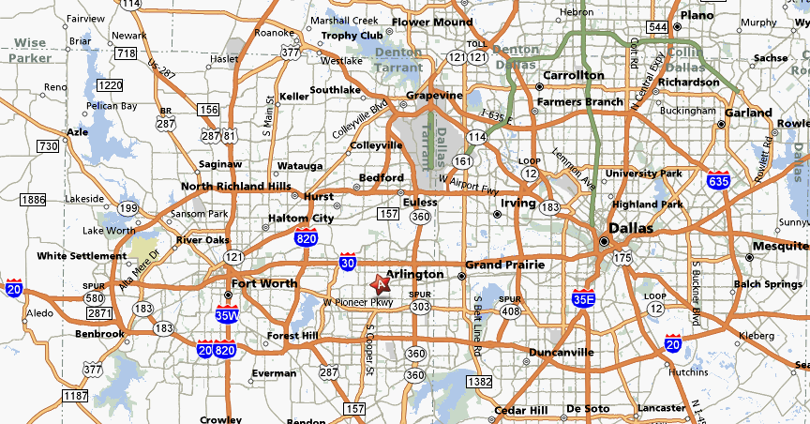
Dallas-Fort Worth Metroplex, Texas
©2015 The University of Texas at Arlington. All Rights Reserved.

Slide 3
The University of Texas at Arlington
“The University of Texas at Arlington is a growing research powerhouse committed to life-enhancing discovery, innovative instruction, and caring community engagement. An educational leader in the heart of the thriving North Texas region, UT Arlington nurtures minds within an environment that values excellence, ingenuity, and diversity.”
Founded in 1895
One of the 9 academic institutions in The University of Texas System
51,000 students (37,008 on-campus), second-largest institution within the UT System
Classified by the Carnegie Foundation as a “Research University/High Research Activity " institution
One of the fastest growing public research universities in the nation
©2015 The University of Texas at Arlington. All Rights Reserved.

Slide 4
Department of Computer Science and Engineering
29 tenured and tenure-track faculty, 11 non-tenure track faculty, 17 adjunct faculty
~110 Ph.D. students, ~800 M.S. students, ~1000 B.S. students
Ranking
#19 Data Mining, #19 Machine Learning and Pattern Recognition, #35 Databases (source: Microsoft Academic Search, 2014)
Computer Engineering (Graduate) #83 (source: U.S. News, 2016)
Computer Science (Graduate) #90 (source: U.S. News, 2014)
Major areas of research: Big Data and Large-Scale Computing, Biocomputing and Health Informatics, Computer Networks, Computer Vision and Multimedia, Database and Information Systems, Embedded Systems and Mobile Computing, Machine Learning and Data Mining, Robotics and AI, Security and Privacy, Software Engineering, Sustainable Computing
©2015 The University of Texas at Arlington. All Rights Reserved.

Slide 5
The Innovative Database and Information Systems Research (IDIR) Laboratory
Research areas
Big Data and Data Science (Database, Data Mining, Web Data Management, Information Retrieval)
Theme of current research
building large-scale human-assisting and human-assisted data and information systems with high usability, low cost and applications for social good
Research directions
computational journalism
crowdsourcing and human computation
data exploration by ranking/skyline/preference queries
database testing
entity search and entity query
graph database usability
©2015 The University of Texas at Arlington. All Rights Reserved.

Slide 6
Our Computational Journalism Project
Started in 2010. Collaborative project with Duke, Google Research, HP Labs, Stanford
Story finding: finding and monitoring number-based facts pertinent to real-world events. The facts are leads to news stories.
Fact checking: discovering and checking factual claims in political discourses, social media, and news.
©2015 The University of Texas at Arlington. All Rights Reserved.

Slide 7
Publications
Detecting Check-worthy Factual Claims in Presidential Debates. Naeemul Hassan, Chengkai Li, Mark Tremayne. CIKM 2015, pages 1835-1838.
The Quest to Automate Fact-Checking. Naeemul Hassan, Bill Adair, James Hamilton, Chengkai Li, Mark Tremayne, Jun Yang and Cong Yu. 2015 Computation+Journalism Symposium.
Online Frequent Episode Mining. Xiang Ao, Ping Luo, Chengkai Li, Fuzhen Zhuang, and Qing He. ICDE 2015, pages 891-902.
Data In, Fact Out: Automated Monitoring of Facts by FactWatcher. Naeemul Hassan, Afroza Sultana, You Wu, Gensheng Zhang, Chengkai Li, Jun Yang, and Cong Yu. VLDB 2014, pages 1557-1560. Demonstration description. (excellent demonstration award)
Finding, Monitoring, and Checking Claims Computationally Based on Structured Data. Brett Walenz, You (Will) Wu, Seokhyun (Alex) Song, Emre Sonmez, Eric Wu, Kevin Wu, Pankaj K. Agarwal, Jun Yang, Naeemul Hassan, Afroza Sultana, Gensheng Zhang, Chengkai Li, Cong Yu. 2014 Computation+Journalism Symposium.
©2015 The University of Texas at Arlington. All Rights Reserved.

Slide 8
Publications (cont’d)
Toward Computational Fact-Checking. You Wu, Pankaj K. Agarwal, Chengkai Li, Jun Yang, Cong Yu. VLDB 2014, pages 589-600.
iCheck: computationally combating "lies, d-ned lies, and statistics". You Wu, Brett Walenz, Peggy Li, Andrew Shim, Emre Sonmez, Pankaj K. Agarwal, Chengkai Li, Jun Yang, Cong Yu. SIGMOD 2014, pages 1063-1066.
Incremental Discovery of Prominent Situational Facts. Afroza Sultana, Naeemul Hassan, Chengkai Li, Jun Yang, Cong Yu. ICDE 2014, pages 112-123.
Discovering General Prominent Streaks in Sequence Data. Gensheng Zhang, Xiao Jiang, Ping Luo, Min Wang, Chengkai Li. ACM TKDD, 8(2):article 9, June 2014.
Discovering and Learning Sensational Episodes of News Events. Xiang Ao, Ping Luo, Chengkai Li, Fuzhen Zhuang, Qing He, and Zhongzhi Shi. WWW 2014, pages 217-218.
©2015 The University of Texas at Arlington. All Rights Reserved.

Slide 9
Publications (cont’d)
On "One of the Few" Objects. You Wu, Pankaj K. Agarwal, Chengkai Li, Jun Yang, Cong Yu. KDD 2012, pages 1487-1495.
Prominent Streak Discovery in Sequence Data. Xiao Jiang, Chengkai Li, Ping Luo, Min Wang, Yong Yu. KDD 2011, pages 1280-1288.
Computational Journalism: A Call to Arms to Database Researchers. Sarah Cohen, Chengkai Li, Jun Yang, Cong Yu. CIDR 2011, pages 148-151. (3rd place in best Outrageous Ideas and Vision (OIV) Track paper competition)
©2015 The University of Texas at Arlington. All Rights Reserved.

Slide 10

The Quest to Automate Fact-Checking
©2015 The University of Texas at Arlington. All Rights Reserved.

Slide 11
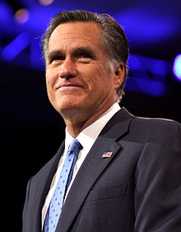

People Make Claims All The Time
“… our Navy is smaller than it's been since 1917", said Republican candidate Mitt Romney in third presidential debate in 2012.
http://en.wikipedia.org/wiki/Mitt_Romney
http://www.thebrainchildgroup.com/
©2015 The University of Texas at Arlington. All Rights Reserved.

Slide 12
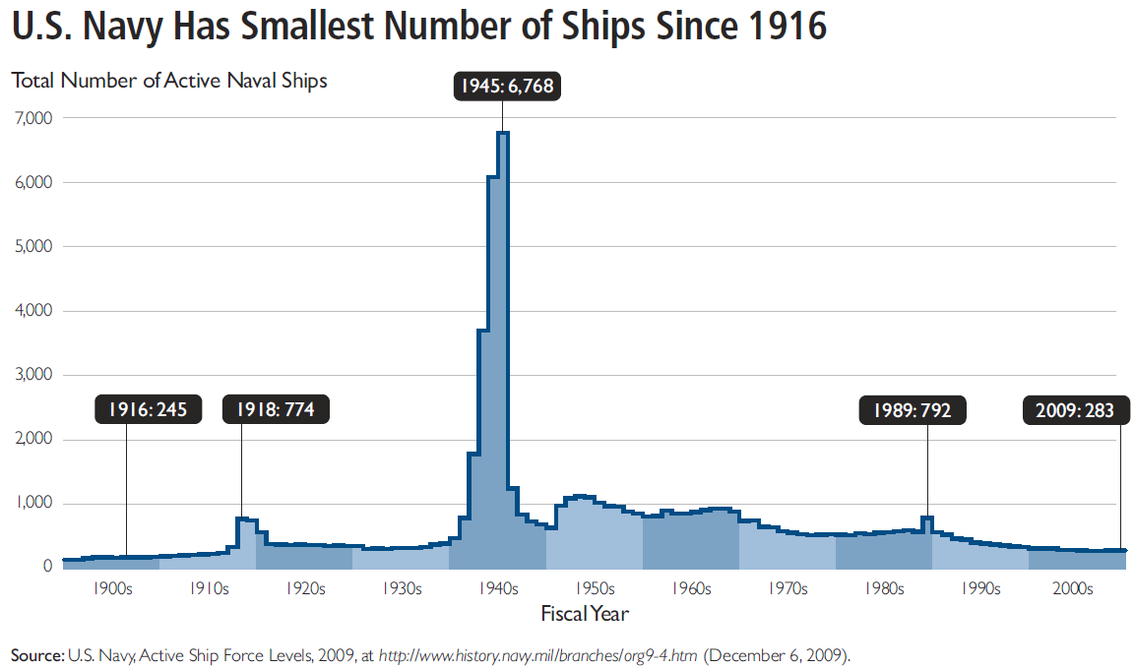
Fact Checking is not Easy
“… our Navy is smaller than it's been since 1917", said Republican candidate Mitt Romney in third presidential debate in 2012.
http://en.wikipedia.org/wiki/Mitt_Romney
http://s3.amazonaws.com/thf_media/2010/pdf/Military_chartbook.pdf
©2015 The University of Texas at Arlington. All Rights Reserved.

Slide 13
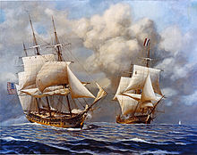
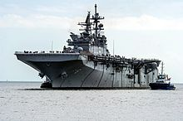
Fact Checking is not Easy
“… our Navy is smaller than it's been since 1917", said Republican candidate Mitt Romney in third presidential debate in 2012.
vs
http://en.wikipedia.org/wiki/Mitt_Romney
http://s3.amazonaws.com/thf_media/2010/pdf/Military_chartbook.pdf
http://en.wikipedia.org/wiki/United_States_Navy
©2015 The University of Texas at Arlington. All Rights Reserved.

Slide 14
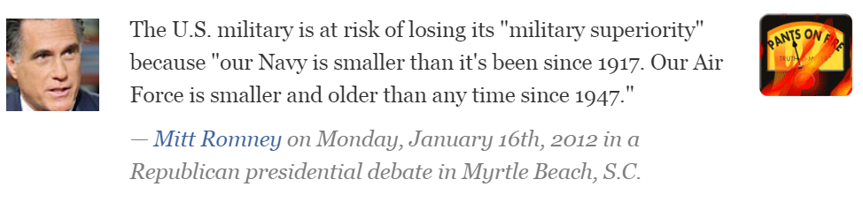
Existing Fact Checking Projects
Journalists and reporters spend good amount of time on fact checking
PolitiFact http://www.politifact.com/
FactCheckEU https://factcheckeu.org/
FullFact http://fullfact.org/
Snopes http://www.snopes.com/info/whatsnew.asp
Factcheck http://www.factcheck.org/
©2015 The University of Texas at Arlington. All Rights Reserved.

Slide 15
Numerous Claims to Check. Rise of Fact-Checkers
Republican candidate debate, August 6, 2015.¹
9 facts checked by factcheck.org
8 facts checked by CNN
24 facts checked by PolitiFact
64 active fact-checking sites in 2015, 44 in 2014. ²
http://time.com/3988276/republican-debate-primetime-transcript-full-text/
http://reporterslab.org/snapshot-of-fact-checking-around-the-world-july-2015/
©2015 The University of Texas at Arlington. All Rights Reserved.

Slide 16
Limitations of Current Fact-Checking Practices
Journalists spend hours going through documents to identify claims.
Significant time gap between speech and reporting times. Audience doesn’t get correct information.
Requires advanced writing skills to persuade readers. Such skilled writers are sparse.
Lack of Structured Journalism and use of old publishing frameworks hinders Semantic Web applications.
©2015 The University of Texas at Arlington. All Rights Reserved.

Slide 17
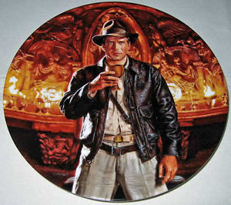
The Holy Grail: Automated, Live Fact-Checking
©2015 The University of Texas at Arlington. All Rights Reserved.

Slide 18
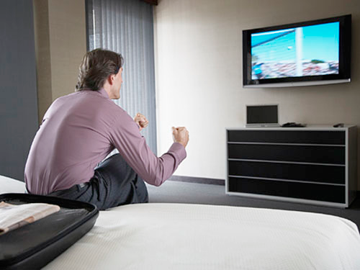
The Holy Grail
Source: Bill Adair
©2015 The University of Texas at Arlington. All Rights Reserved.

Slide 19

The Holy Grail
Source: Bill Adair
©2015 The University of Texas at Arlington. All Rights Reserved.

Slide 20

The Holy Grail
Source: Bill Adair
©2015 The University of Texas at Arlington. All Rights Reserved.

Slide 21
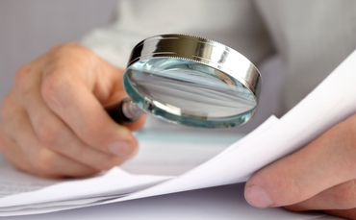
ClaimBuster
political discourses (debates, interviews), advertisements, live events on TV and online video streams
social media (e.g., twitter)
web pages
news articles
repository of already-checked claims
important factual claims
detector
matcher
no match
matched
assist data analysis; solicit analyses from professionals
display existing fact-checkers, delivered via browser extensions, mobile and smart-TV apps
www.wsandb.co.uk/wsb/news/2405401/european-court-rules-insurers-need-to-include-economic-consequences-of-policies#
www.outsidethebeltway.com
©2015 The University of Texas at Arlington. All Rights Reserved.

Slide 22
ClaimBuster
political discourses (debates, interviews), advertisements, live events on TV and online video streams
social media (e.g., twitter)
web pages
news articles
repository of already-checked claims
important factual claims
detector
matcher
no match
matched
assist data analysis; solicit analyses from professionals
display existing fact-checkers, delivered via browser extensions, mobile and smart-TV apps
www.wsandb.co.uk/wsb/news/2405401/european-court-rules-insurers-need-to-include-economic-consequences-of-policies#
www.outsidethebeltway.com
©2015 The University of Texas at Arlington. All Rights Reserved.

Slide 23
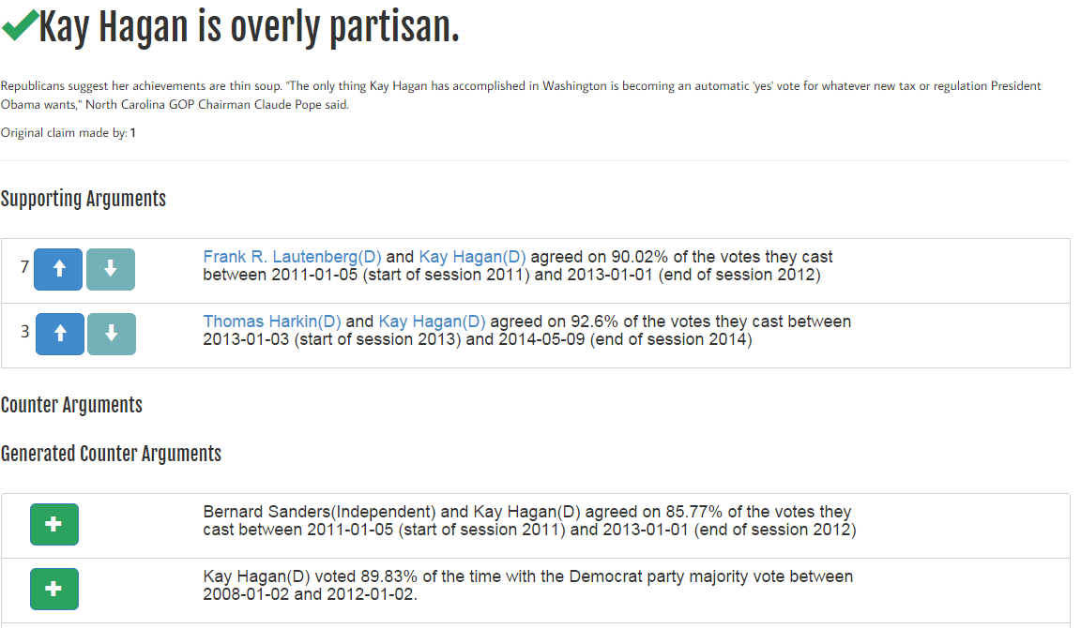
iCheck (Led by Duke)
©2015 The University of Texas at Arlington. All Rights Reserved.

Slide 24
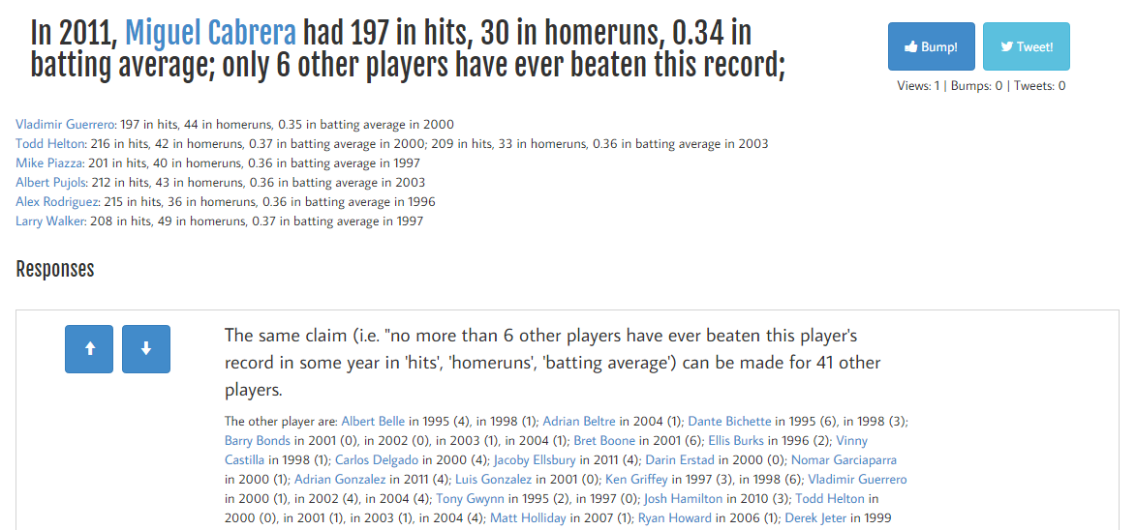
iCheck (Led by Duke)
©2015 The University of Texas at Arlington. All Rights Reserved.

Slide 25
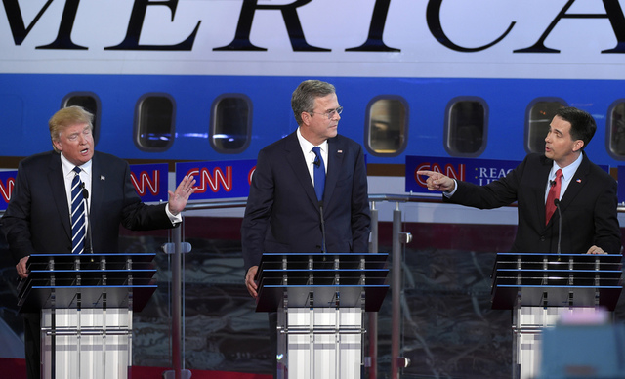
ClaimBuster to be 2016-Ready
Factual claims recommended to be checked
2016
Presidential
Debates
Journalists investigate the claims
(Speeches, debates, interviews, social media, news)
(or checked by algorithms, citizens, crowd)
©2015 The University of Texas at Arlington. All Rights Reserved.

Slide 26
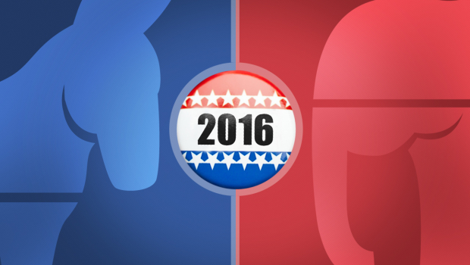




Finding Important Factual Claims: A Classification Problem
2016
Presidential
Debates
Human Annotation
Feature Extraction
Learning Algorithm
Ground Truth
Feature Vectors
Presidential Debate Transcripts
Important factual claims
©2015 The University of Texas at Arlington. All Rights Reserved.

Slide 27
Dataset: Presidential Debate Transcripts
Source: http://www.debates.org/index.php?page=debate-transcripts
All 30 debates (11 elections) in history: 1960, 1976—2012
20k sentences by presidential candidates: removed very short (< 5 words) sentences
©2015 The University of Texas at Arlington. All Rights Reserved.

Slide 28
3 Classes of Sentences
Important factual claims
“We spend less on the military today than at any time in our history.” “The President’s position on gay marriage has changed.” “More people are unemployed today than four years ago.”
Unimportant factual claims
“I was in Iowa yesterday.” “My mother enjoys cooking.” “I ran for President once before.”
Sentences with no factual claims (just opinions, questions & declarations)
“Iran must not get nuclear weapons.” “7% unemployment is too high.” “My opponent is wishy-washy.” “I will be tough on crime.” "Why should we do that?“ “Hello, New Hampshire!” “Our plan is to reduce tax rate by 10%.”
Goal: Given a future sentence, find the class it belongs to.
©2015 The University of Texas at Arlington. All Rights Reserved.

Slide 29
Ground Truth Collection
Developed a data collection platform bit.ly/claimbusters.
In 3 months, we accumulated 226 participants.
Used 600 screening sentences to detect spammers & low-quality participants.
Admitted sentences which are agreed by at least 2 top-quality participants.
8015 such sentences.
Class | Count
CFS | 1673
UFS | 482
NFS | 5860
©2015 The University of Texas at Arlington. All Rights Reserved.

Slide 30
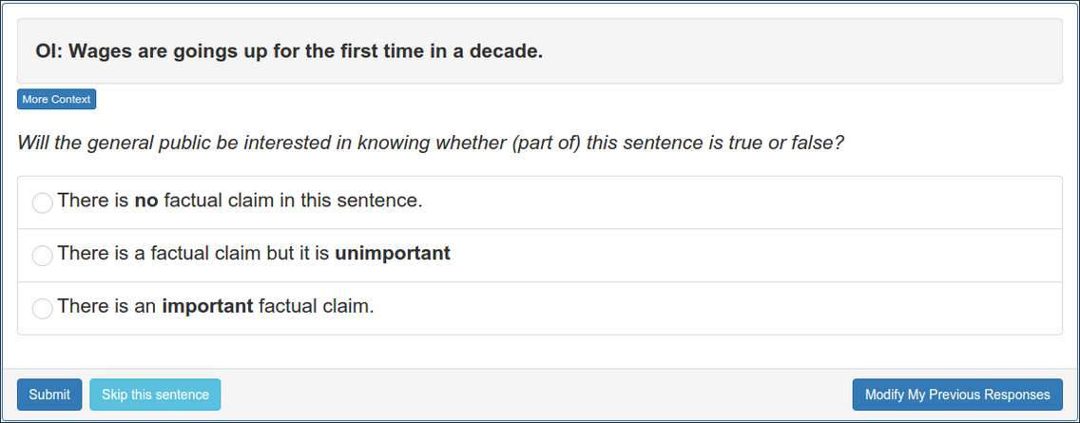
Ground Truth Collection Website
©2015 The University of Texas at Arlington. All Rights Reserved.

Slide 31
Feature Extraction
Keywords:
state, legislature, 87, percent, democrat
Sentiment: 0.032
I was in a state where my legislature was 87 percent Democrat.
Part-of-Speech:
Noun
Entity Type:
Quantity
Concept:
United States
Sentiment: [-1.0 to 1.0]
Words: tf-idf scores of 6130 words (excluding rare words)
POS Tag: 43 tags
Entity Type: 26 types
©2015 The University of Texas at Arlington. All Rights Reserved.

Slide 32
Feature Selection
6201 features in total
Used a Random Forest Classifier to calculate importance of each feature.
Most Important Feature: POS tag ‘Cardinal Number’
©2015 The University of Texas at Arlington. All Rights Reserved.

Slide 33
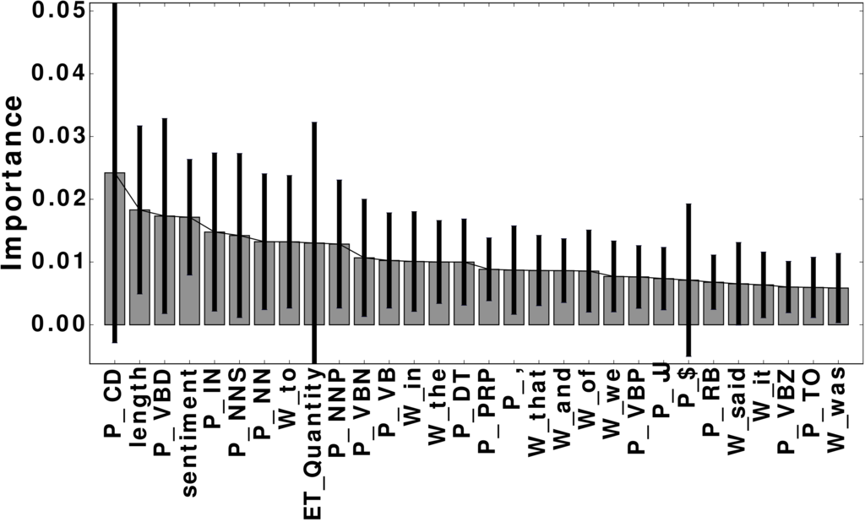
Important Features
Word | percent; people; jobs
POS tag | noun; cardinal number; past tense; preposition
Entity Type | Quantity; Country; FieldTerminology; Person
Concept | United States Senate; Barack Obama
©2015 The University of Texas at Arlington. All Rights Reserved.

Slide 34
Implementation: Python NLP/ML Tools
Data wrangling
Use NLTK (Natural Language Toolkit) to transform debate files into structured data format
Use mysql-python-connector to store extracted features into an MySQL database
Use matplotlib to plot classifiers’ performance.
Feature extraction
Use AlchemyAPI (Python wrapper) to extract rich features of sentences
Classification
Use scikit-learn to build classification models
©2015 The University of Texas at Arlington. All Rights Reserved.

Slide 35
Evaluation: Classification
4-fold cross validation
Algorithms: Naive Bayes, Random Forest & Support Vector Machine
Support Vector Machine performed better than others in general.
 | Precision | Recall | F-measure
NFS | 0.90 | 0.96 | 0.93
UFS | 0.65 | 0.26 | 0.37
CFS | 0.79 | 0.74 | 0.77
©2015 The University of Texas at Arlington. All Rights Reserved.

Slide 36
Evaluation: Ranking
Measured accuracy of top-K sentences.
ClaimBuster has a strong agreement with high-quality human coders on the check-worthiness of sentences
K | P@K | NDCG@K
25 | 1 | 1
50 | 1 | 1
100 | 0.960 | 0.970
200 | 0.940 | 0.951
300 | 0.853 | 0.881
500 | 0.690 | 0.840
©2015 The University of Texas at Arlington. All Rights Reserved.

Slide 37
Case Study: #GOPDebate2015
Near real-time experiment with 2015 first Republican primary debate
Transcript grabbed from closed captions of the Fox News channel using TextGrabber
1393 sentences
71% of the fact-checks from CNN, factcheck.org & PolitiFact were ranked by ClaimBuster within top 18%.
©2015 The University of Texas at Arlington. All Rights Reserved.

Slide 38
Case Study: #GOPDebate2015
CNN Claim | Associated sentence(s)[From TextGrabber] | Score
1 | Part of this iranian deal was lifting the international sanctions on general sulemani. | 0.415
2 | I would go on to add – >> you don’t favor – >> i have never said that. | 0.511
3 | A majority of the candidates on this stage supported amnesty. | 0.295
4 | Timely the medicaid is growing at one of the lowest rates in the country. | 0.534
4 | We went from $8 billion in the hole to $5 million in the black. | 0.773
5 | And the mexican government is much smarter, much sharper, much more cunning and they send the bad ones over because they don’t want to pay for them. | 0.215
6 | [Not found in the transcript] | N/A
©2015 The University of Texas at Arlington. All Rights Reserved.

Slide 39
Case Study: #GOPDebate2015
Real-time experiment with 2015 second Republican primary debate
Closed Captions from CNN channel
Tweeted important factual claims to https://twitter.com/ClaimBusterTM, live!
©2015 The University of Texas at Arlington. All Rights Reserved.

Slide 40
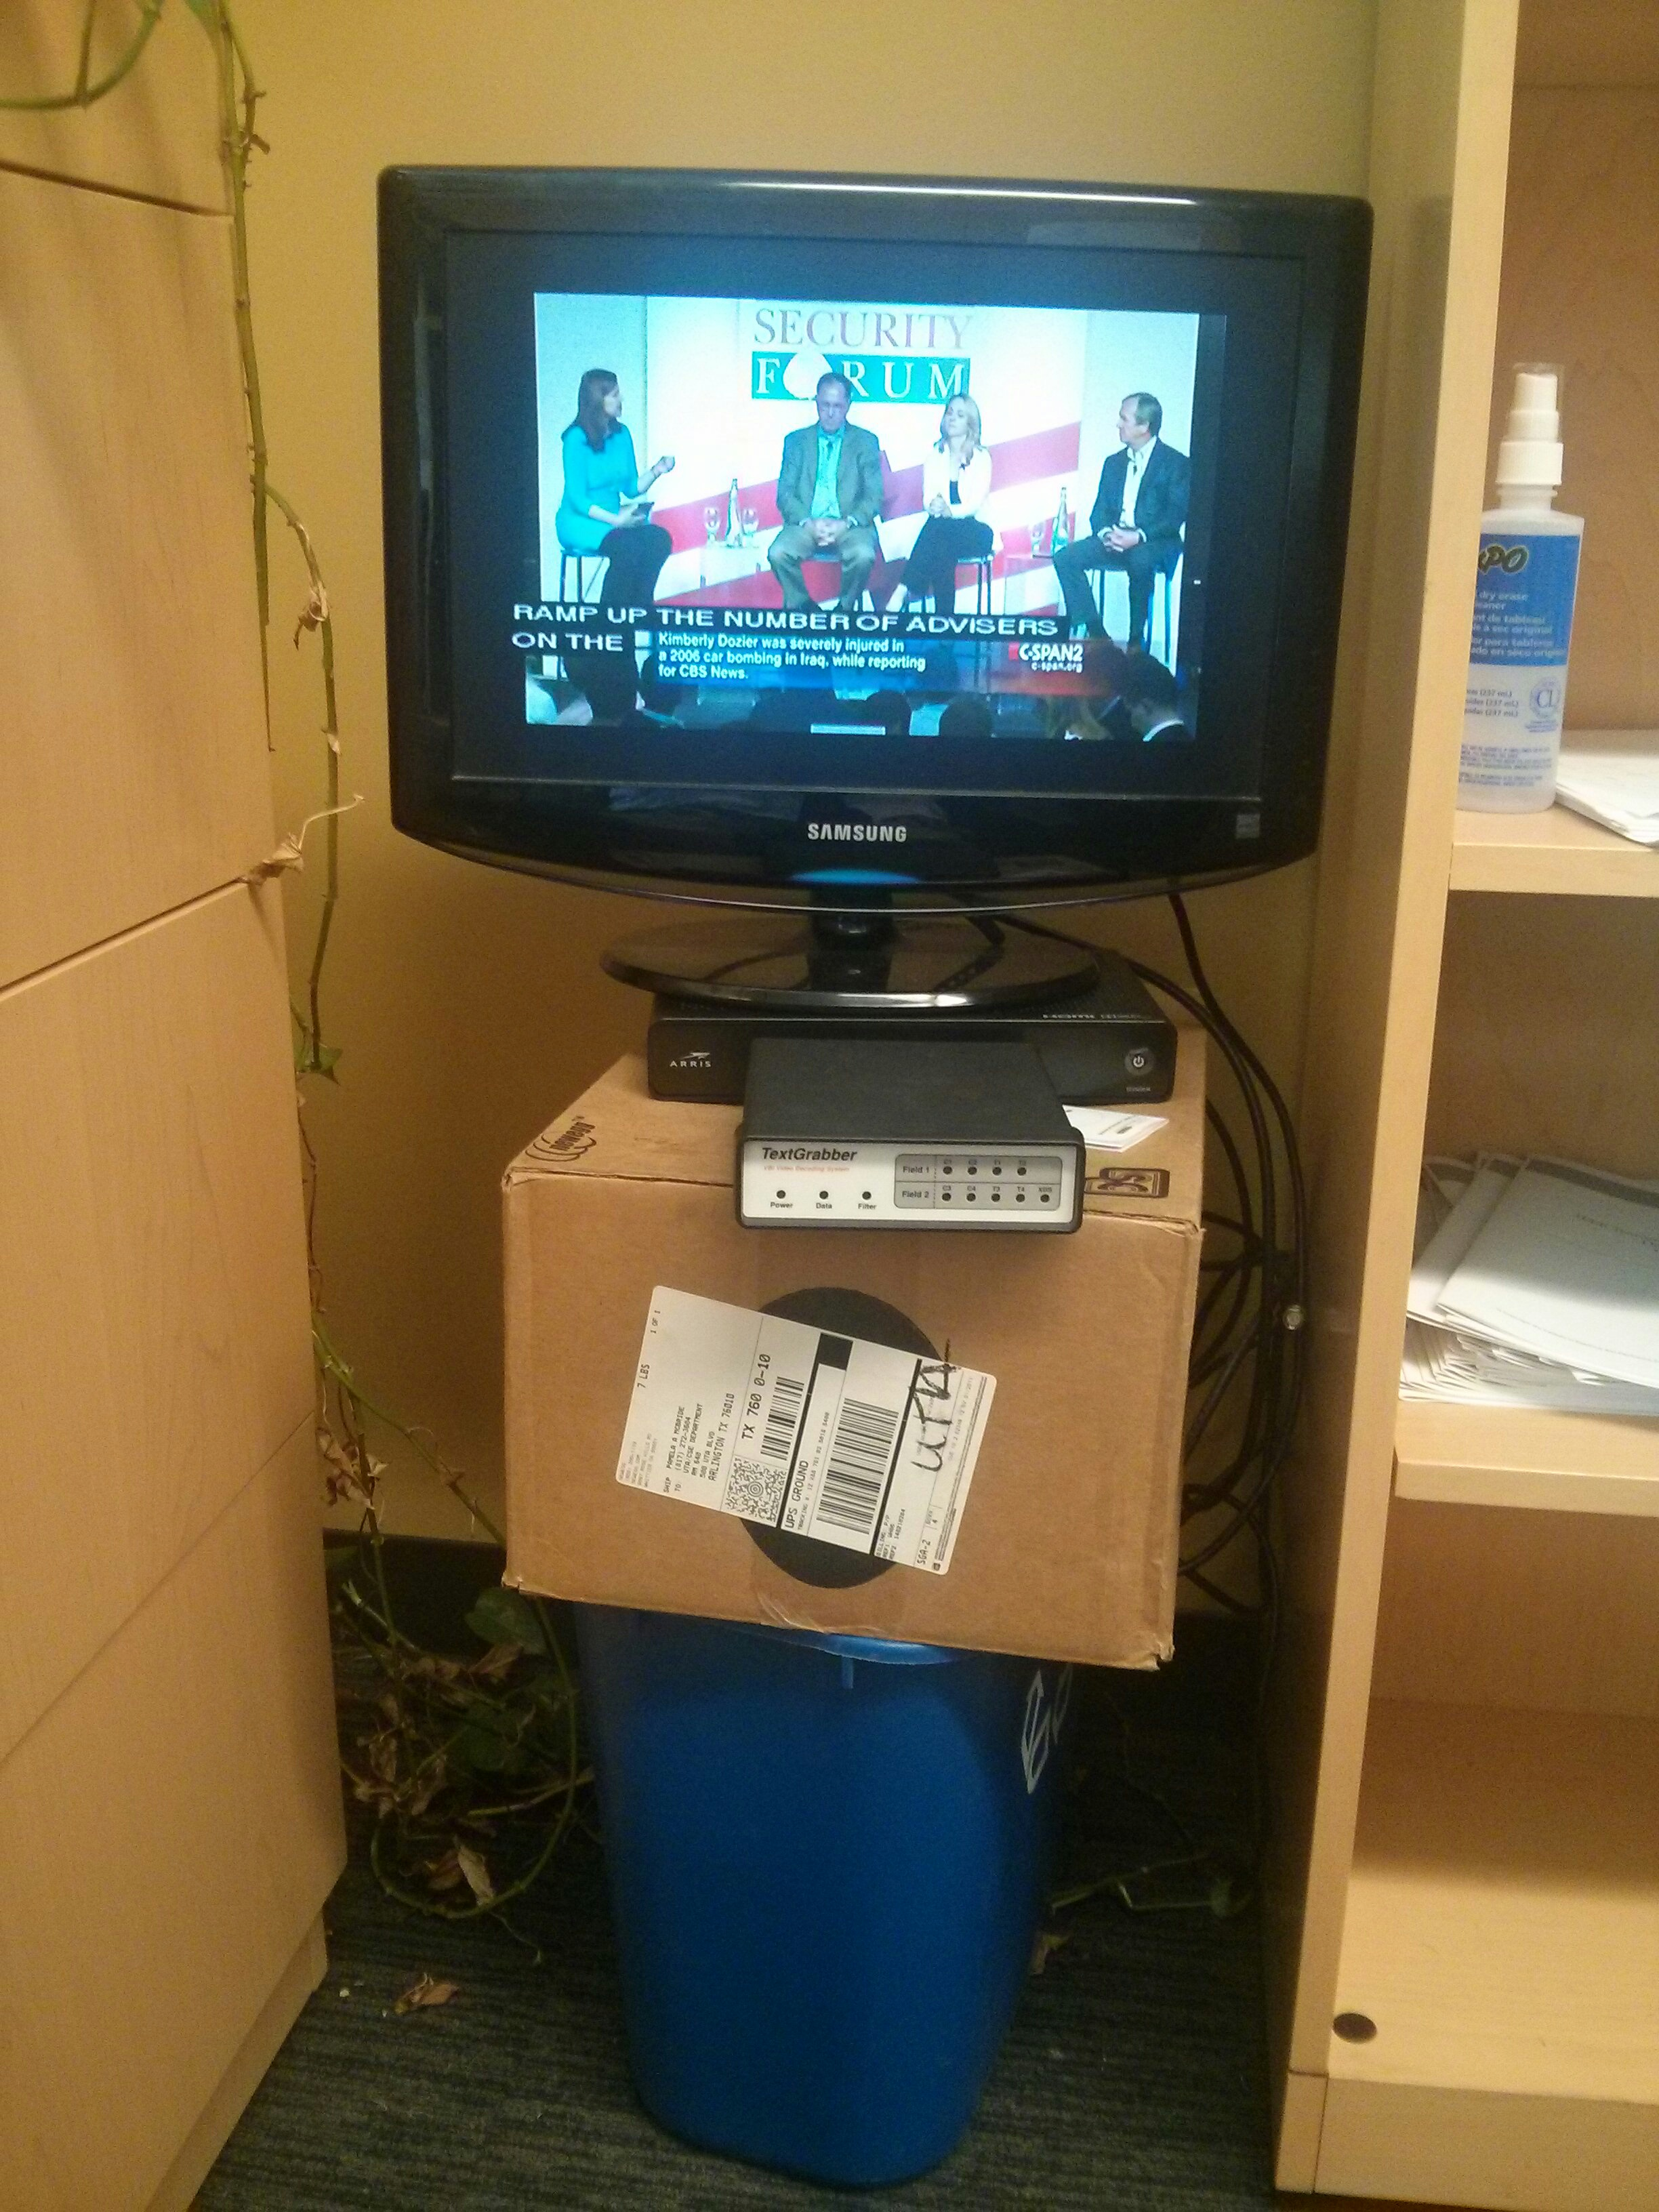
©2015 The University of Texas at Arlington. All Rights Reserved.

Slide 41
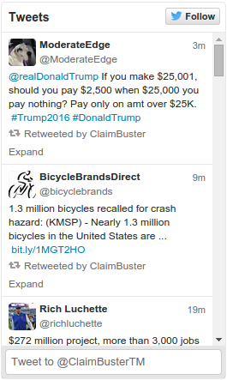
©2015 The University of Texas at Arlington. All Rights Reserved.

Slide 42
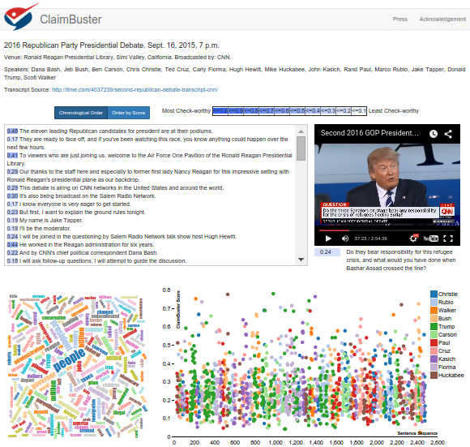

Demo
http://idir.uta.edu/claimbuster
©2015 The University of Texas at Arlington. All Rights Reserved.

Slide 43
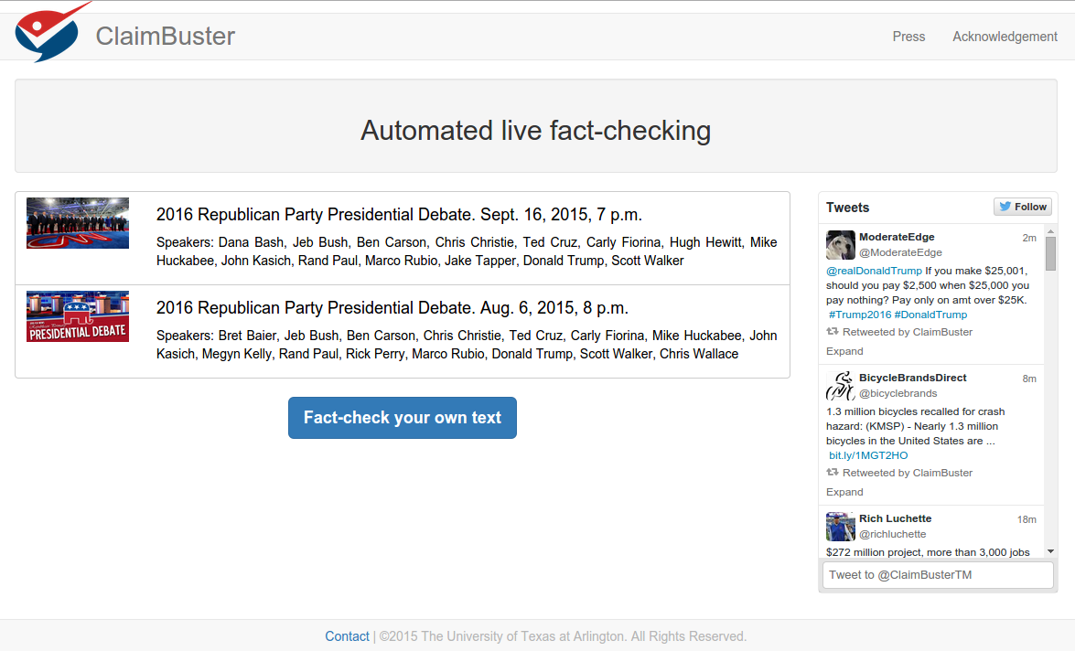
©2015 The University of Texas at Arlington. All Rights Reserved.

Slide 44
©2015 The University of Texas at Arlington. All Rights Reserved.

Slide 45
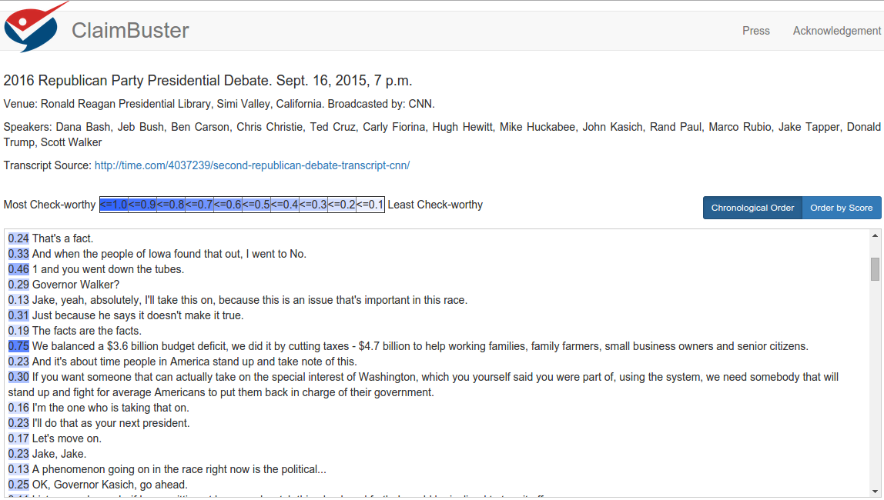
©2015 The University of Texas at Arlington. All Rights Reserved.

Slide 46
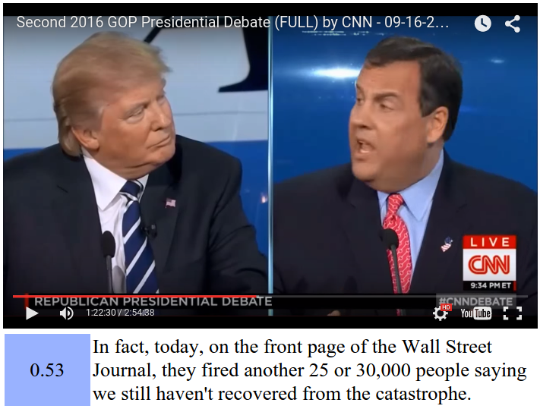
©2015 The University of Texas at Arlington. All Rights Reserved.

Slide 47
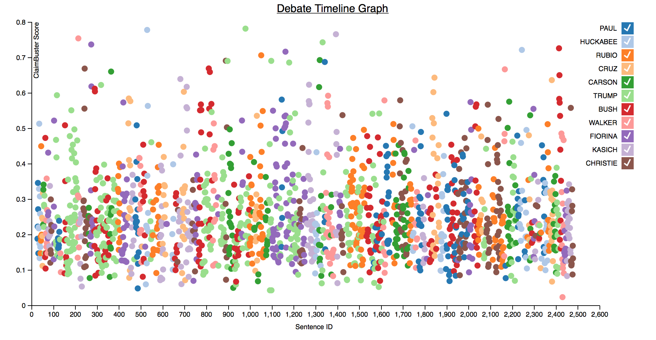
©2015 The University of Texas at Arlington. All Rights Reserved.

Slide 48
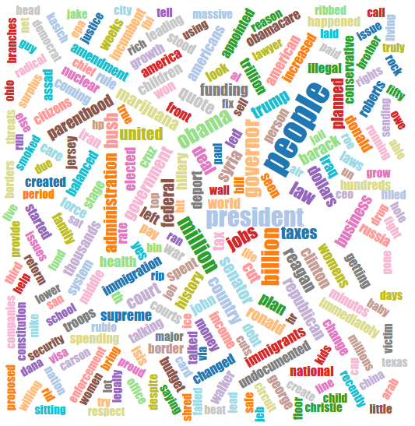
©2015 The University of Texas at Arlington. All Rights Reserved.

Slide 49
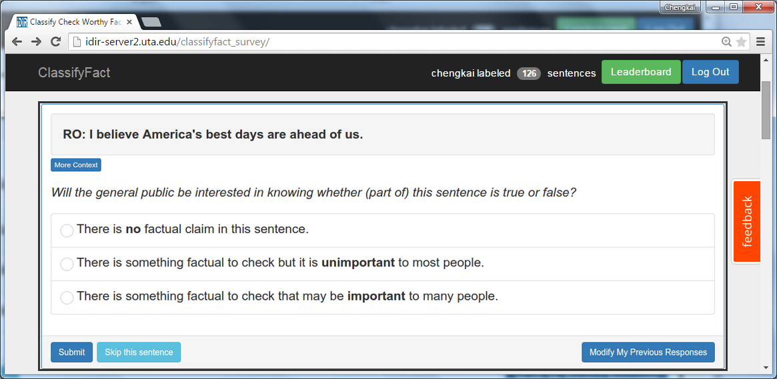

You are Invited
http://bit.ly/claimbusters
©2015 The University of Texas at Arlington. All Rights Reserved.

Slide 50
FactWatcher
Automated Monitoring of Facts from Real-World Events
©2015 The University of Texas at Arlington. All Rights Reserved.

Slide 51
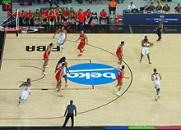
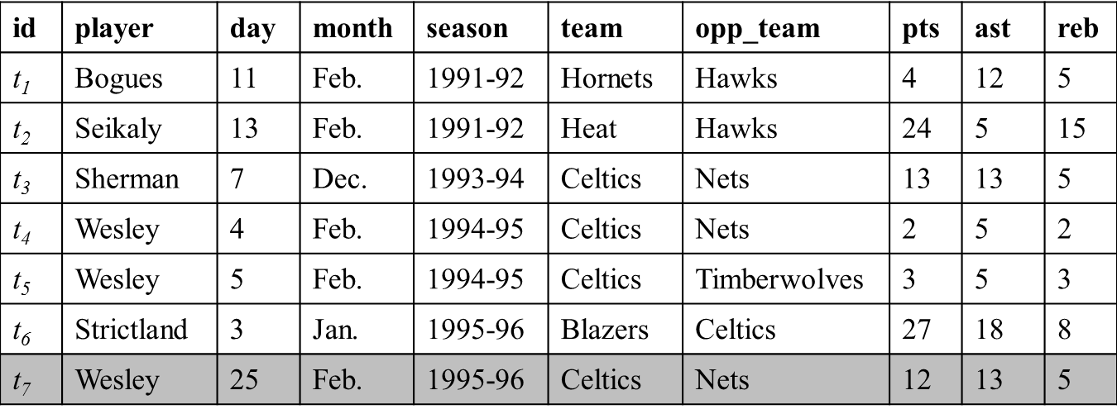
FactWatcher (Fact Finding)
Tuple t for new real world event appended to database
Constraint | Measure
month=Feb | pts, ast, reb
opp_team=Nets | ast, reb
team=Celtics & opp_team=Nets | ast, reb
… | …
Find constraint-measure pair (C, M) such that t is in the contextual skyline
Wesley had 12 points, 13 assists and 5 rebounds on February 25, 1996 to become the first player with a 12/13/5 (points/assists/rebounds) in February.
Generate factual claim
http://en.wikipedia.org/wiki/Basketball
©2015 The University of Texas at Arlington. All Rights Reserved.

Slide 52
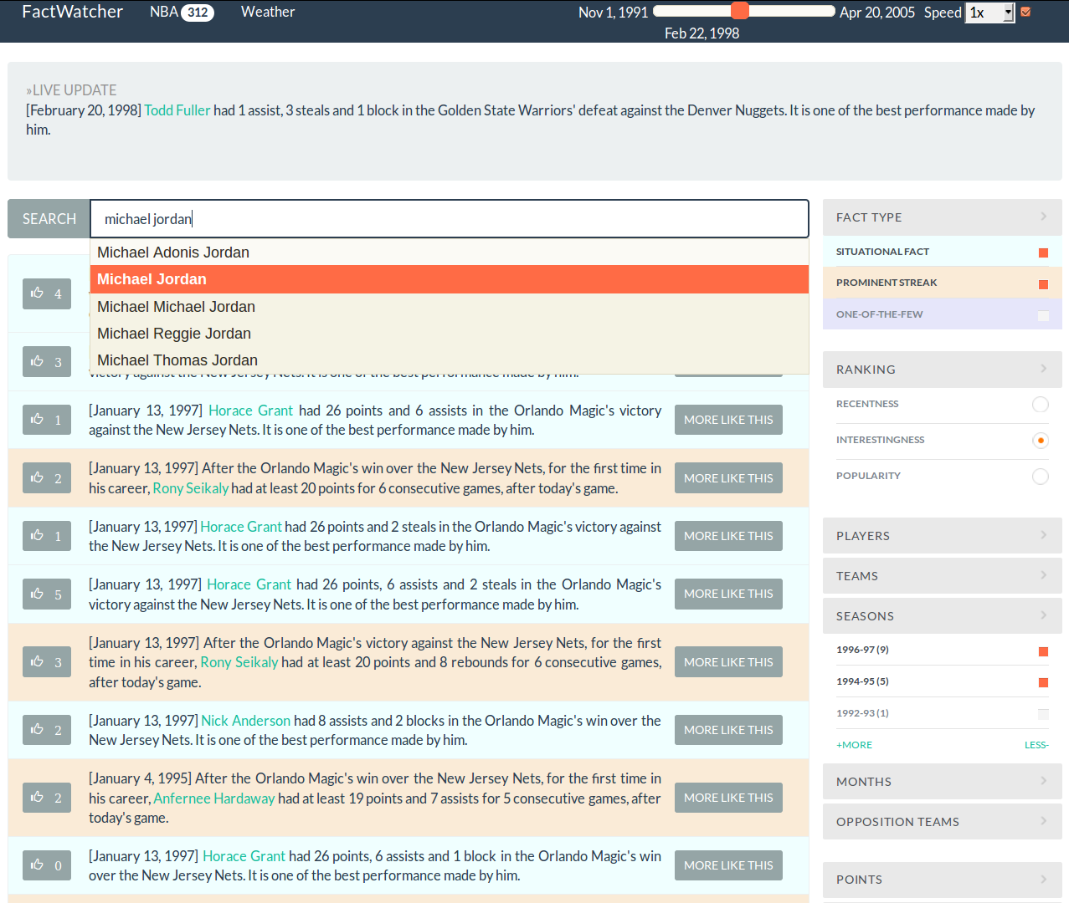


Presented In
Excellent Demo Award
http://idir.uta.edu/factwatcher/
©2015 The University of Texas at Arlington. All Rights Reserved.

Slide 53
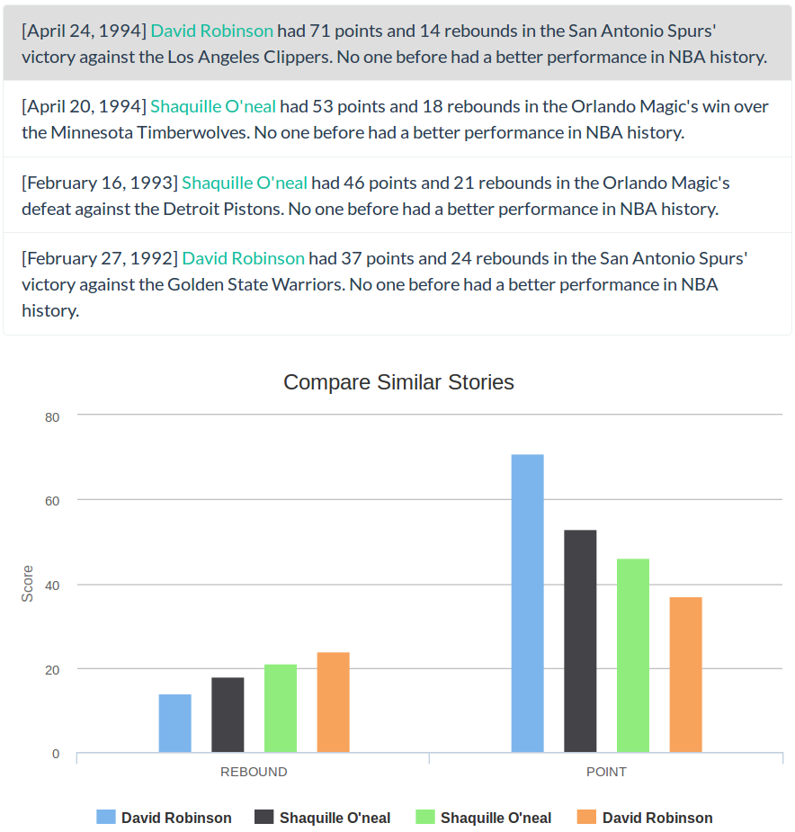
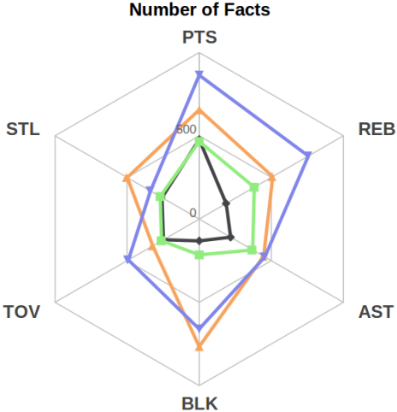
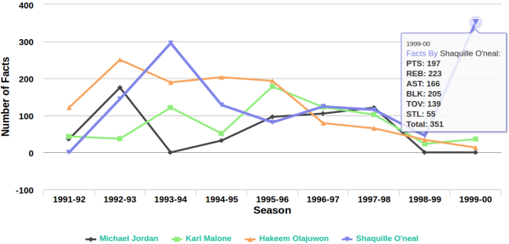
©2015 The University of Texas at Arlington. All Rights Reserved.

Slide 54
FactWatcher Finds Three Types of Facts (and can be Extended)
Domains
sports, weather, crimes, transportation, finance, social media analytics
Examples from Real News Media
Prominent streaks
“This month the Chinese capital has experienced 10 days with a maximum temperature in around 35 degrees Celsius – the most for the month of July in a decade.” http://www.chinadaily.com.cn/china/2010-07/27/content_11055675.htm
“The Nikkei 225 closed below 10000 for the 12th consecutive week, the longest such streak since June 2009.”
http://www.bloomberg.com/news/articles/2010-08-06/japanese-stocks-fall-for-second-day-this-week-on-u-s-jobless-claims-yen
©2015 The University of Texas at Arlington. All Rights Reserved.

Slide 55
FactWatcher Finds Three Types of Facts (and can be Extended)
Examples from Real News Media
Situational facts, One-of-the-few objects
“Paul George had 21 points, 11 rebounds and 5 assists to become the first Pacers player with a 20/10/5 (points/rebounds/assists) game against the Bulls since Detlef Schrempf in December 1992.” http://espn.go.com/espn/elias?date=20130205
“The social world’s most viral photo ever generated 3.5 million likes, 170,000 comments and 460,000 shares by Wednesday afternoon.” http://www.cnbc.com/id/49728455
©2015 The University of Texas at Arlington. All Rights Reserved.

Slide 56
Demo
http://idir.uta.edu/factwatcher/
©2015 The University of Texas at Arlington. All Rights Reserved.

Slide 57
Acknowledgment
UTA Students
Naeemul Hassan
Afroza Sultana
Gensheng Zhang
Joseph Minumol
Fatma Dogan
Collaborators
Bill Adair (Duke)
Pankaj Agarwal (Duke)
Sarah Cohen (Columbia)
James Hamilton (Stanford)
Ping Luo (Chinese Academy of Sciences)
Mark Tremayne (UTA)
Min Wang (Google Research)
Jun Yang (Duke)
Cong Yu (Google Research)
©2015 The University of Texas at Arlington. All Rights Reserved.

Slide 58




Acknowledgment
Funding sponsors
Disclaimer: This material is based upon work partially supported by the National Science Foundation Grants 1018865, 1117369 and 1408928, 2011 and 2012 HP Labs Innovation Research Awards, and the National Natural Science Foundation of China Grant 61370019. Any opinions, findings, and conclusions or recommendations expressed in this material are those of the author(s) and do not necessarily reflect the views of the funding agencies.
©2015 The University of Texas at Arlington. All Rights Reserved.

Slide 59
Thank You! Questions?
http://ranger.uta.edu/~cli
http://idir.uta.edu
cli@uta.edu
Please help us label the data
http://bit.ly/claimbusters
©2015 The University of Texas at Arlington. All Rights Reserved.

Slide 60
Other IDIR Projects
©2015 The University of Texas at Arlington. All Rights Reserved.

Slide 61
CrowdConsensus
Team/organization decision making and event organizer
©2015 The University of Texas at Arlington. All Rights Reserved.

Slide 62
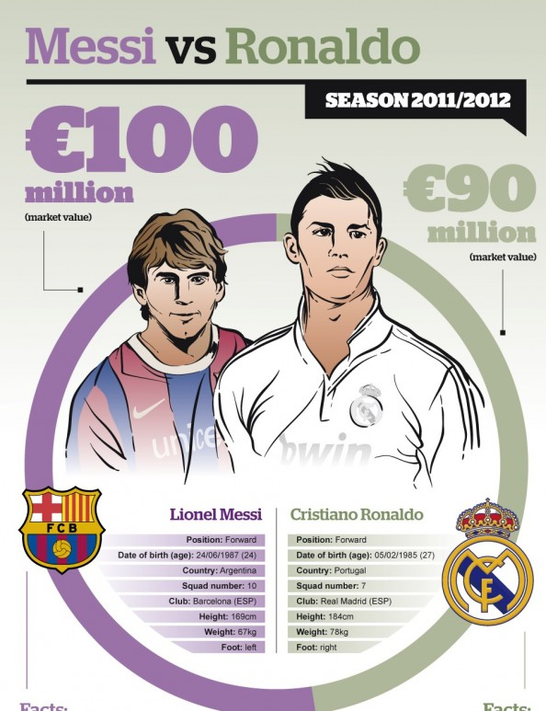


Humans’ Obsession: Comparing Things
Who is the better footballer?
Which is the better company to work for?
http://visual.ly/messi-vs-ronaldo
©2015 The University of Texas at Arlington. All Rights Reserved.

Slide 63
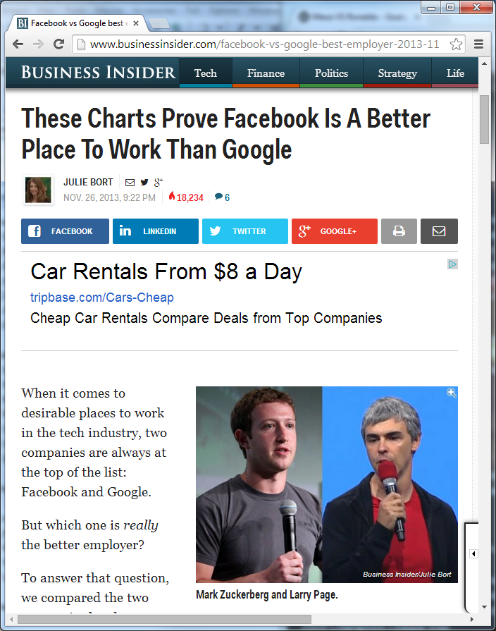
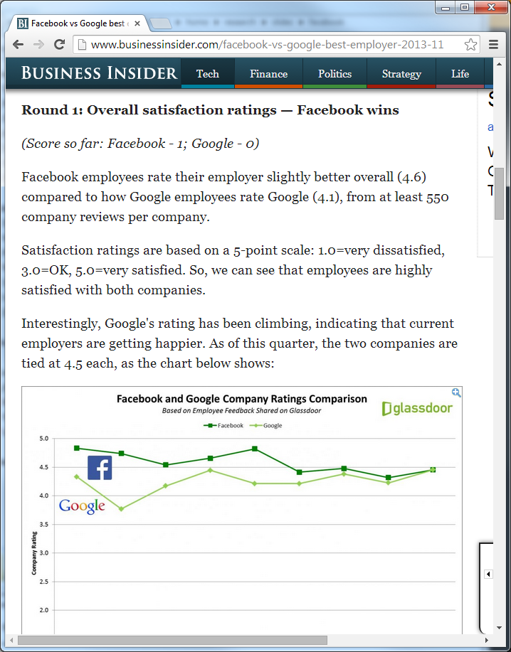
Facebook-Google Showdown
http://www.businessinsider.com/facebook-vs-google-best-employer-2013-11
©2015 The University of Texas at Arlington. All Rights Reserved.

Slide 64
Facebook-Google Showdown
Multiple criteria
Overall satisfaction | CEO approval | Employee confidence in the future | Perks and salaries | Interview difficulty
≻
≻
≻
≻
≻
Which one is better?
©2015 The University of Texas at Arlington. All Rights Reserved.

Slide 65
CrowdConsensus
Optimization techniques and algorithms that minimize questions to users for reaching consensus.
Applications
Collecting Public Opinion
Group Decision Making
Where for lunch, which product to use, which candidate to hire
Information Exploration
Compare photos by color, sharpness, and landscape
©2015 The University of Texas at Arlington. All Rights Reserved.

Slide 66
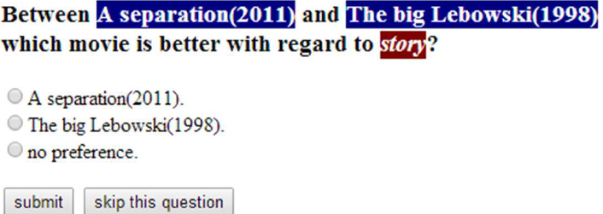
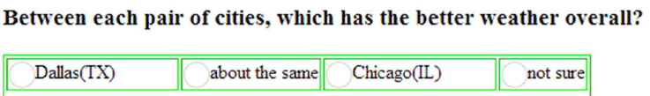
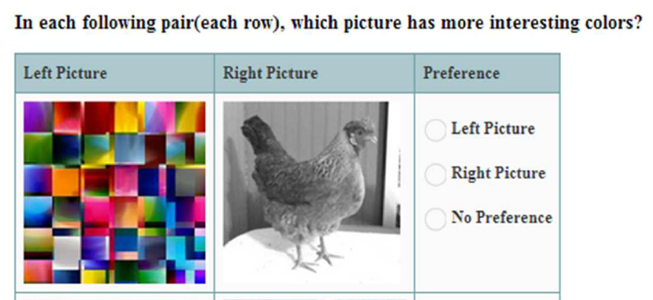
How to Get Preference Relations? Ask the Crowd (mobile apps)
©2015 The University of Texas at Arlington. All Rights Reserved.

Slide 67
CrewScout
Expert Team Formation
©2015 The University of Texas at Arlington. All Rights Reserved.

Slide 68
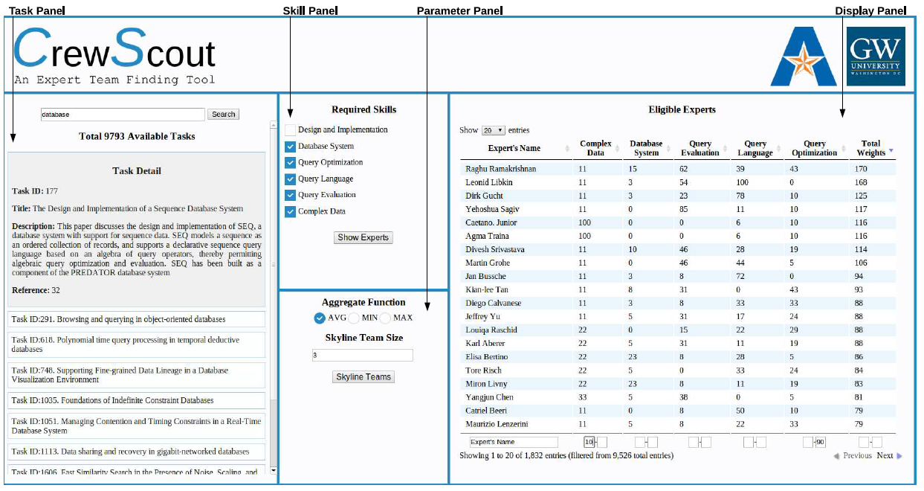
CrewScout --- Expert Team Formation
http://idir.uta.edu/crewscout/
©2015 The University of Texas at Arlington. All Rights Reserved.

Slide 69
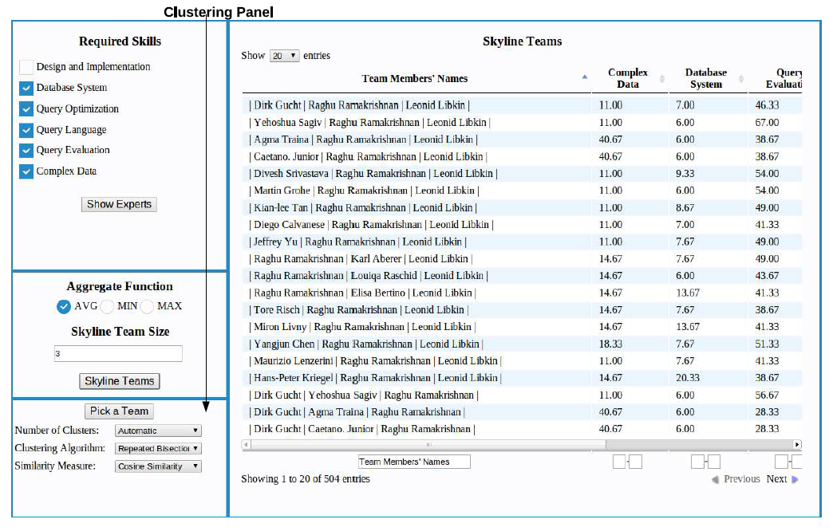
CrewScout http://idir.uta.edu/crewscout/
©2015 The University of Texas at Arlington. All Rights Reserved.

Slide 70
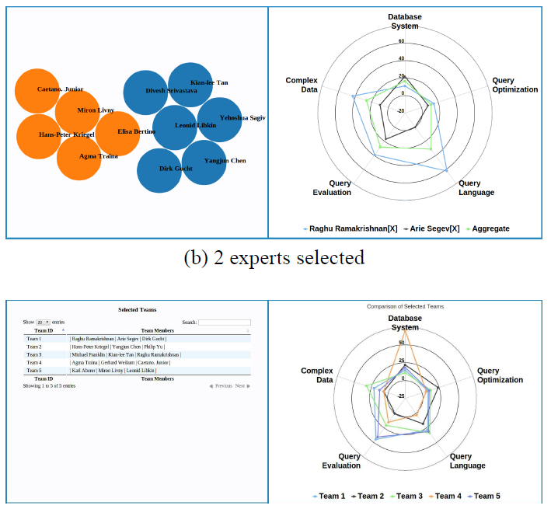
CrewScout http://idir.uta.edu/crewscout/
©2015 The University of Texas at Arlington. All Rights Reserved.

Slide 71
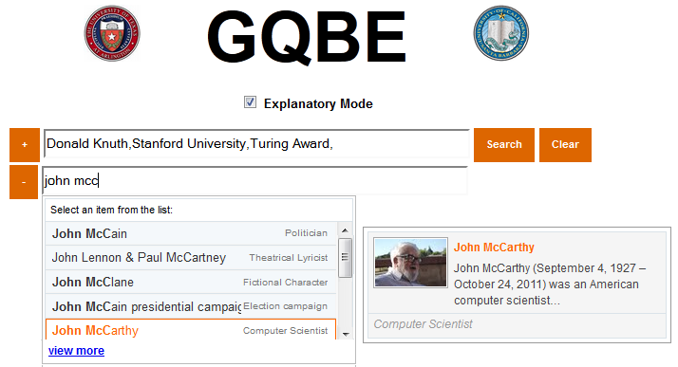
GQBE (Graph Query-by-Example) http://idir.uta.edu/gqbe
On a knowledge graph:
Input: one or more example n-entity tuples
Output: top-k most similar answer n-tuples.
©2015 The University of Texas at Arlington. All Rights Reserved.

Slide 72
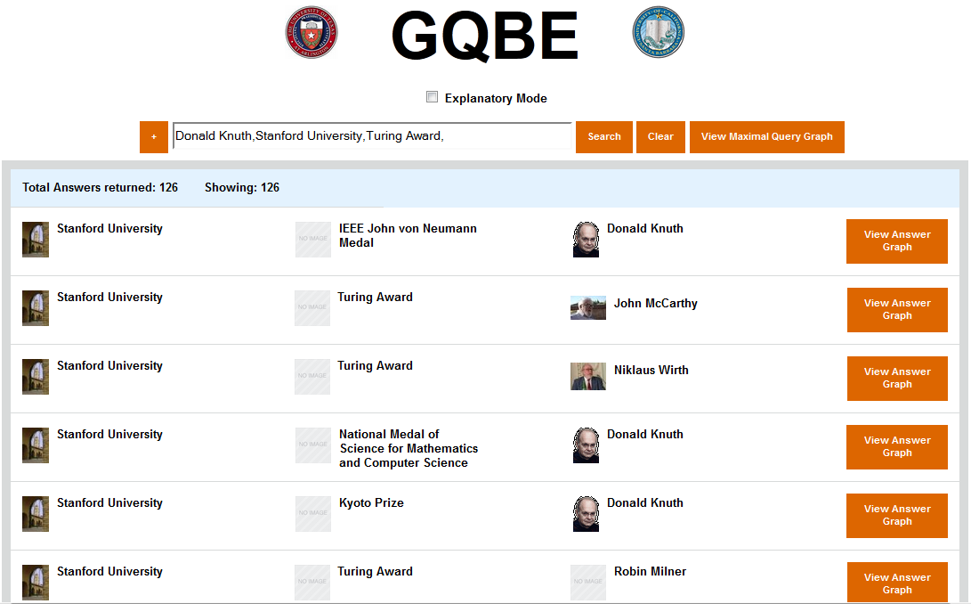
GQBE (Graph Query-by-Example)
©2015 The University of Texas at Arlington. All Rights Reserved.

Slide 73
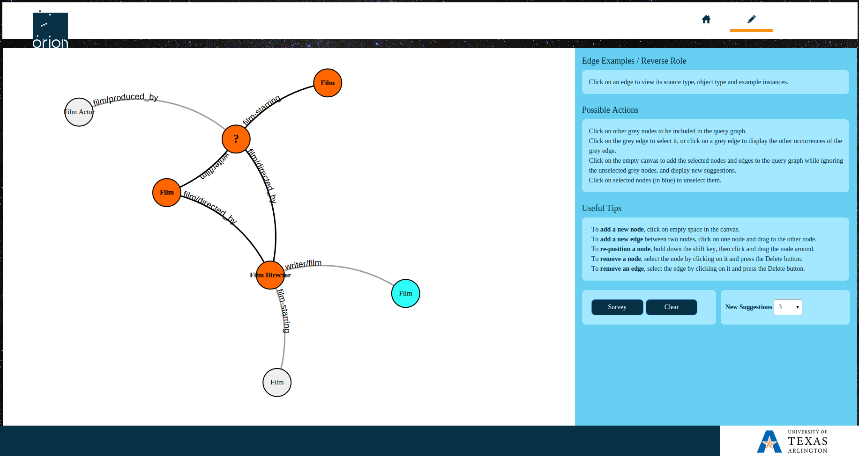
Orion: Auto-suggestion for Interactive Graph Query Formulation http://idir.uta.edu/orion
©2015 The University of Texas at Arlington. All Rights Reserved.

Slide 74
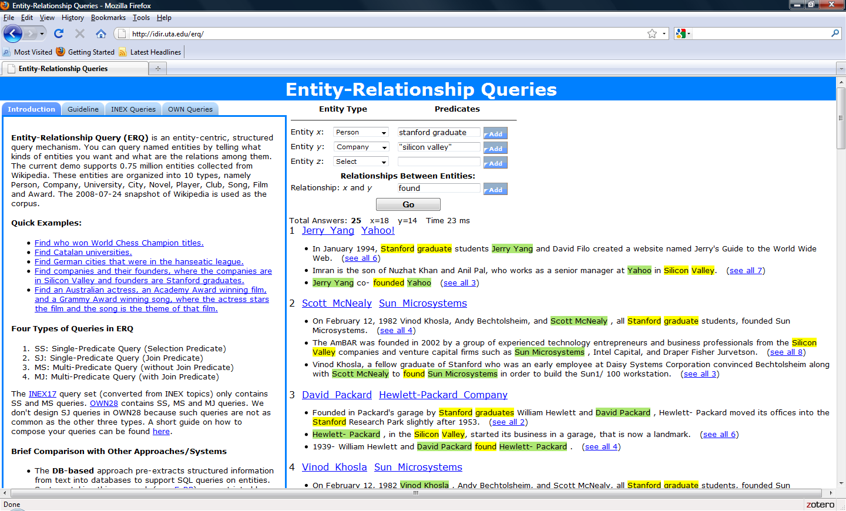
Entity-Relationship Queries (ERQ)
http://idir.uta.edu/erq
©2015 The University of Texas at Arlington. All Rights Reserved.

Slide 75
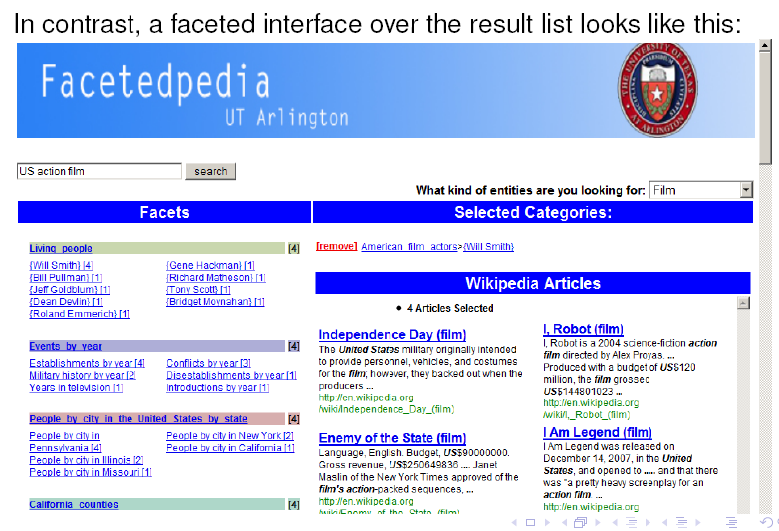
Facetedpedia http://idir.uta.edu/facetedpedia
©2015 The University of Texas at Arlington. All Rights Reserved.

